Slide 1
Flutter

Slide 2


Mohsen Rewards
List in Dart can hold more than one Type
Using dynamic
Can a var variable in Dart hold values of different types
Can you assign a value to a const variable at runtime in Dart
What data type can be used to get an unknown data type
dynamic

Slide 3
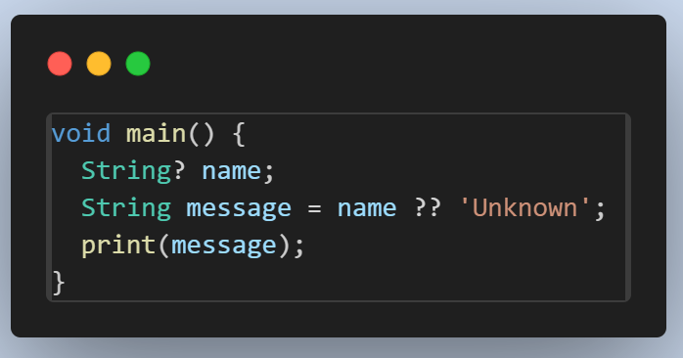
Mohsen Rewards
Output : Unknown

Slide 4
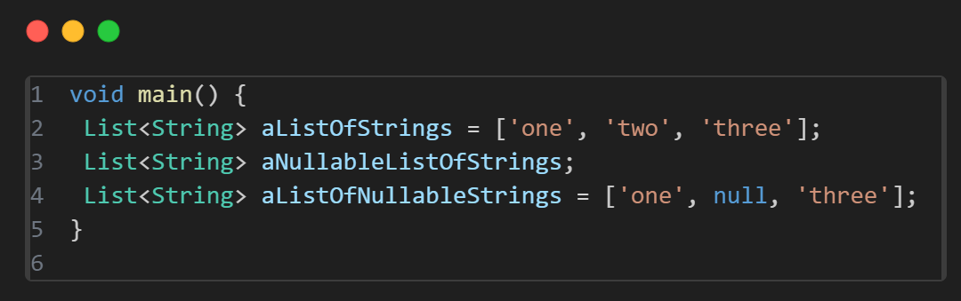
Mohsen Rewards

Slide 5
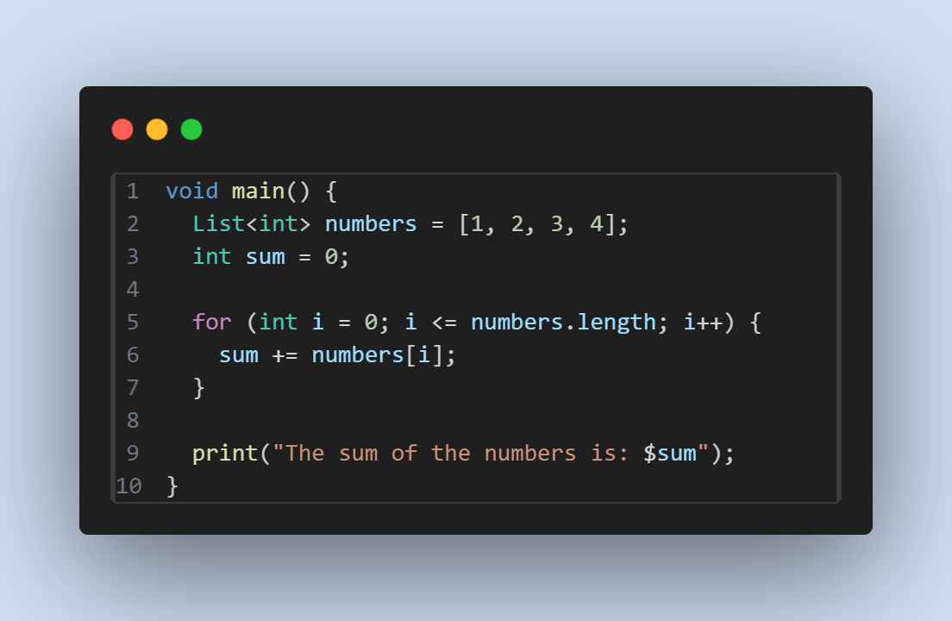
Mohsen Rewards

Slide 6
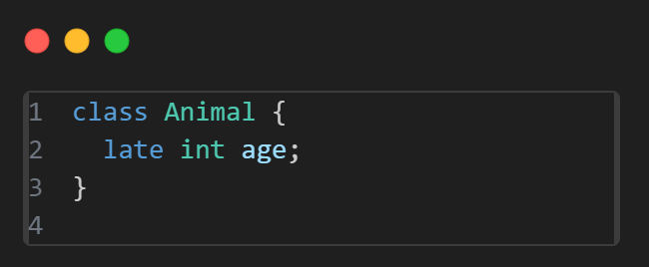
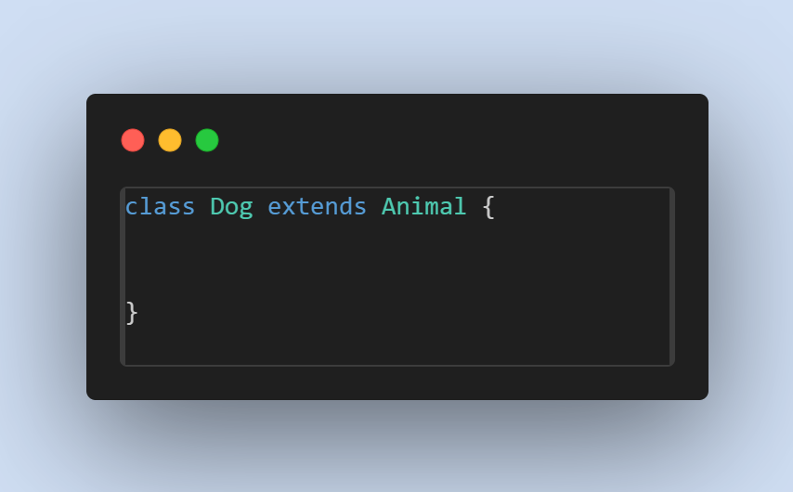
Mohsen Rewards
How do Protected in Dart

Slide 7
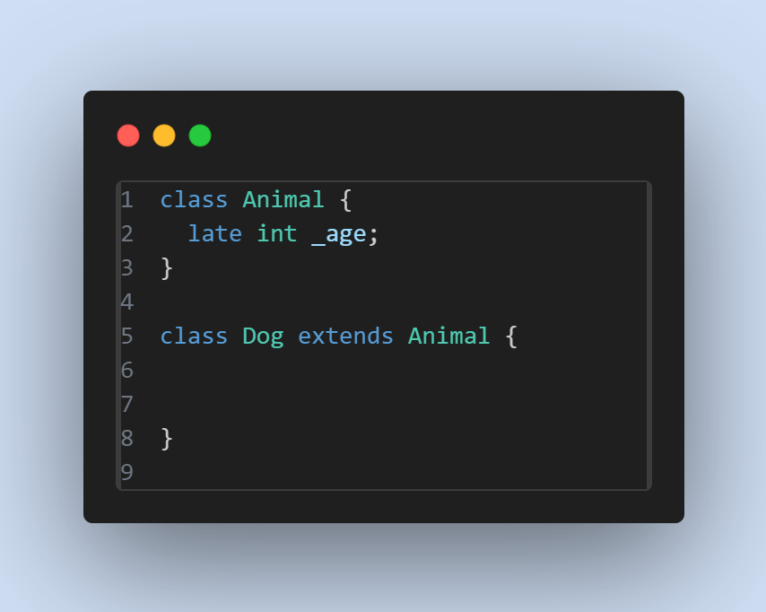
Mohsen Rewards
How do Protected in Dart

Slide 8
Agenda
01
02
03
04
How Flutter app starts
What is Widget
How Flutter app starts
HandsOn

Slide 9
Into to Flutter Environment
Flutter SDK is a framework developed by Google for building cross-platform mobile applications. It provides a complete set of tools, libraries, and resources to create native-like user interfaces (UI) for both Android and iOS
Notes:
First talk about YAML parts of pubspec.yaml YAML (data serialization format)
- It is not a programming language like C++.
- It is not Markup language like HTML.
- YAML is designed to be easily readable and writable by humans.
- It's used for representing configuration settings.
Unlike programming languages such as C++ or Python, YAML doesn't contain functions, conditionals, or loops.

Slide 10
What is Widget
widget is an immutable description of part of a user interface. Widgets can be inflated into elements, which manage the underlying render tree.
Widget type : Visible , Invisible
Notes:
First talk about YAML parts of pubspec.yaml YAML (data serialization format)
- It is not a programming language like C++.
- It is not Markup language like HTML.
- YAML is designed to be easily readable and writable by humans.
- It's used for representing configuration settings.
Unlike programming languages such as C++ or Python, YAML doesn't contain functions, conditionals, or loops.

Slide 11
Visible Widget
related to the user input and output data
Container
width: 200
child: Text(“string”)
Text
(“string”)
textAlign:TextAlign.center
style: TextStyle(height:100)
Button()
child: Text(“string”)
onPressed:(){do something}
Image
image: NetworkImage(“url”)
image: AssetImage()
alignment
ListView
itemBuilder(BuildContexrt,int)
physics:

Slide 12
Invisible Widget
related to the layout and control of widgets. It provides controlling how the widgets actually behave and how they will look onto the screen
MaterialApp
responsible for setting up the overall structure and configuration of a Flutter application
home, theme , navigation
Scaffold
provides a framework that allows you to add common material design elements
AppBar,Floating Action Buttons, Drawers
Column / Row
arranges all its children's widgets in a vertical / horizontal alignment
provides spacing between the widgets by mainAxisAlignment & crossAxisAlignment
Stack
mainly used for overlapping a widget
such as a button on a background gradient

Slide 13

How Flutter app starts
Main function
runApp
build
Material app (1 every app)
Scaffold (1 every screen)
Notes:
First talk about YAML parts of pubspec.yaml YAML (data serialization format)
- It is not a programming language like C++.
- It is not Markup language like HTML.
- YAML is designed to be easily readable and writable by humans.
- It's used for representing configuration settings.
Unlike programming languages such as C++ or Python, YAML doesn't contain functions, conditionals, or loops.

Slide 14
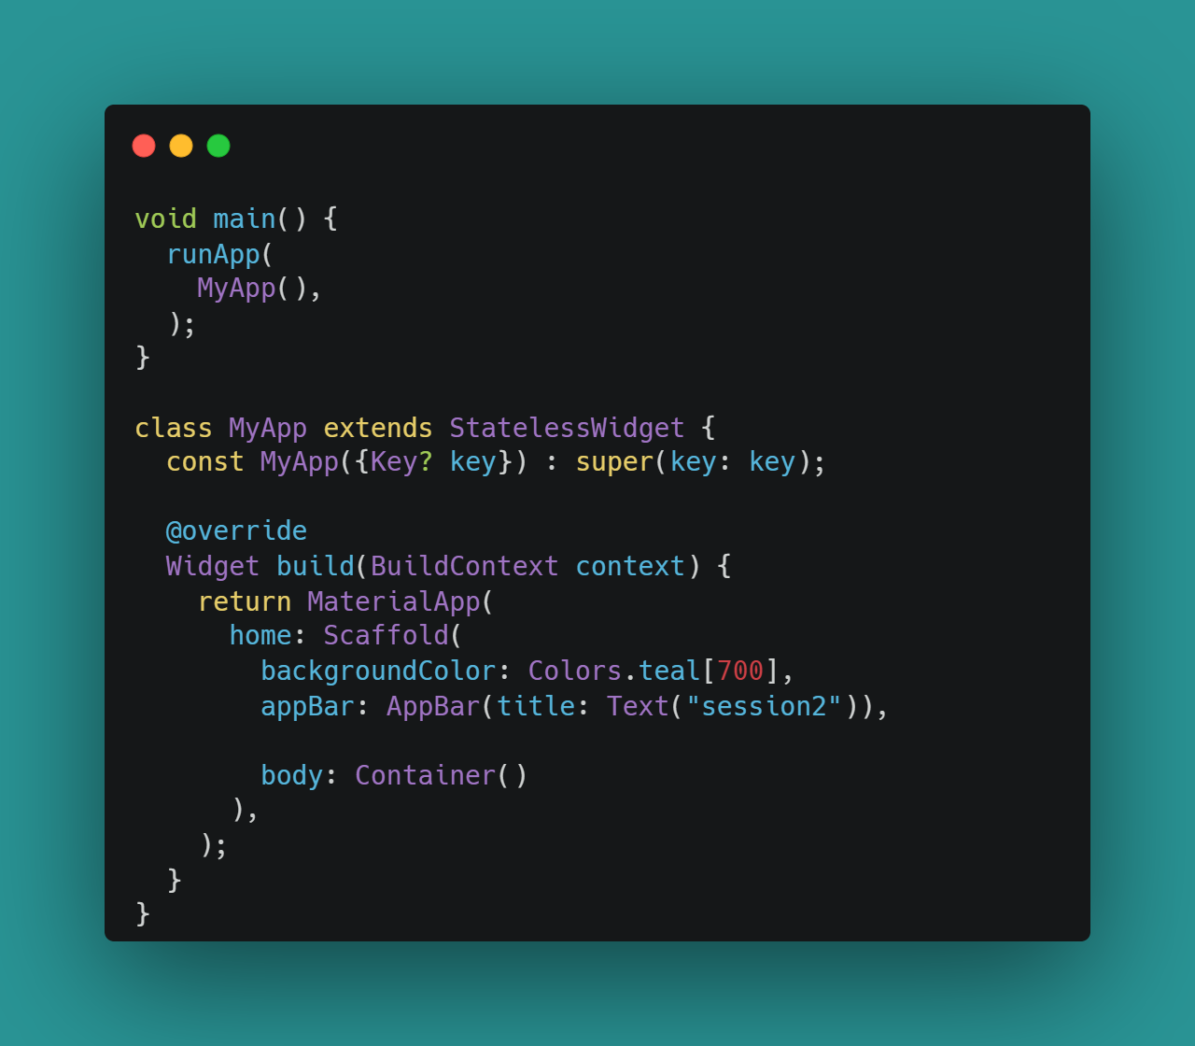
Stateless Widget
A stateless widget never changes
Icon, IconButton, and Text are examples of stateless widgets

Slide 15
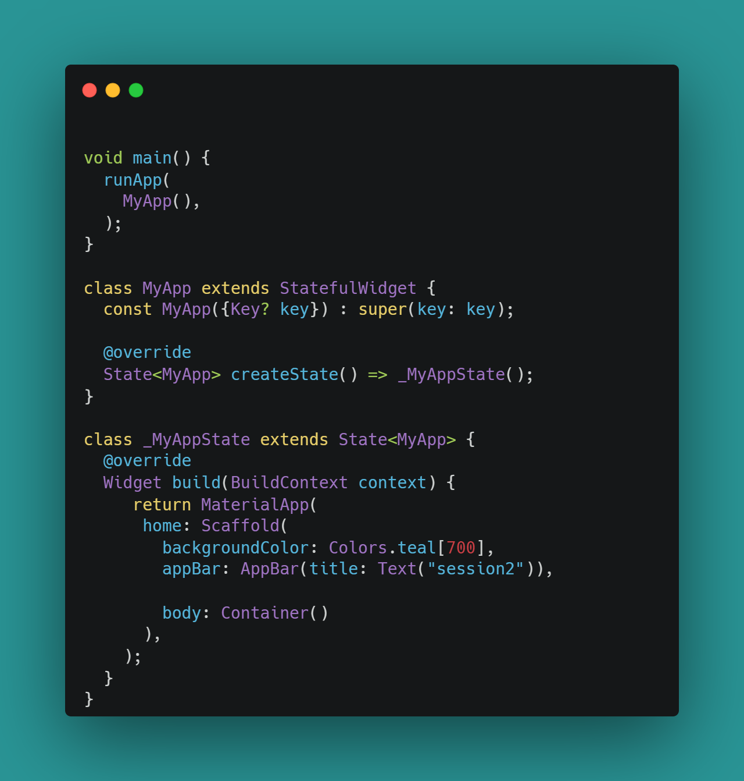
Stateful Widget
A generic method createState() creates a mutable state for the widget at a particular location and returns another class that is extended by the previous state
The _MyAppState class extends another state.
BuildContext: It provides information regarding which widget is to be built/re-build
SetState(): A State object is used to modify the user interface. It executes the code for a particular callback and repaints the widgets that rely on that state for configuration.

Slide 16
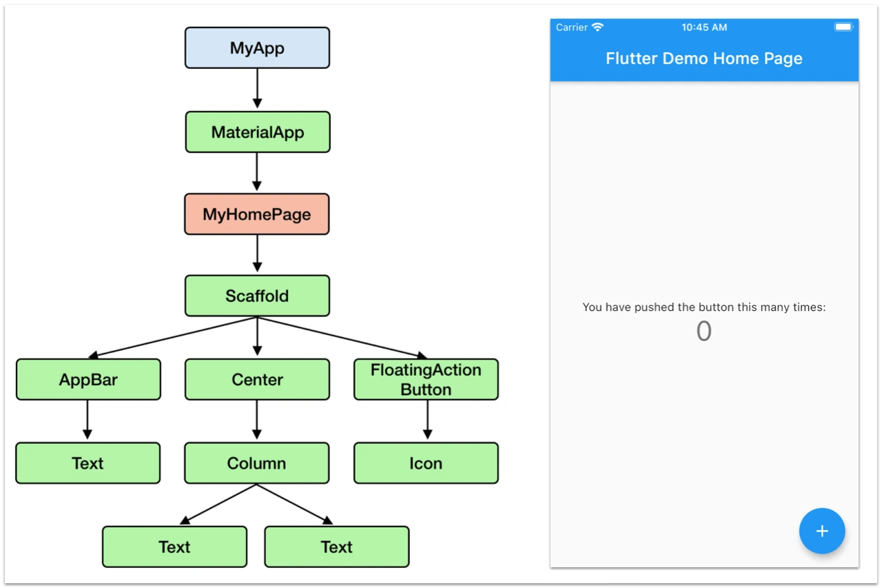
Widget Tree
Notes:
First talk about YAML parts of pubspec.yaml YAML (data serialization format)
- It is not a programming language like C++.
- It is not Markup language like HTML.
- YAML is designed to be easily readable and writable by humans.
- It's used for representing configuration settings.
Unlike programming languages such as C++ or Python, YAML doesn't contain functions, conditionals, or loops.

Slide 17
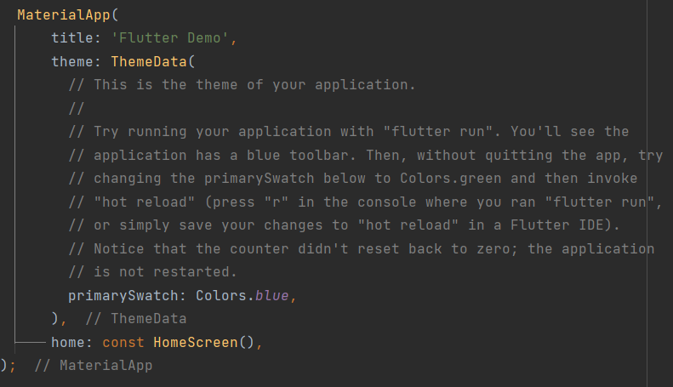
Material app
MaterialApp is a predefined class or widget in a flutter. It is likely the main or core component of a flutter app. The MaterialApp widget provides a wrapper around other Material Widgets
Notes:
First talk about YAML parts of pubspec.yaml YAML (data serialization format)
- It is not a programming language like C++.
- It is not Markup language like HTML.
- YAML is designed to be easily readable and writable by humans.
- It's used for representing configuration settings.
Unlike programming languages such as C++ or Python, YAML doesn't contain functions, conditionals, or loops.

Slide 18
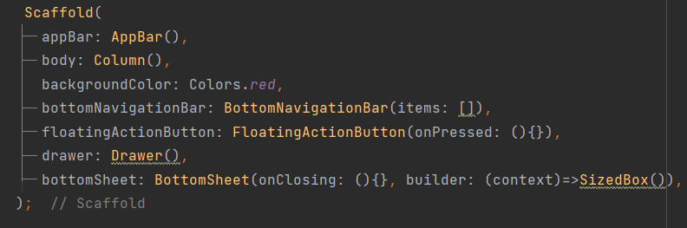
Scaffold
Implements the basic Material Design visual layout structure.
Flutter Widget that provide me one screen
Notes:
First talk about YAML parts of pubspec.yaml YAML (data serialization format)
- It is not a programming language like C++.
- It is not Markup language like HTML.
- YAML is designed to be easily readable and writable by humans.
- It's used for representing configuration settings.
Unlike programming languages such as C++ or Python, YAML doesn't contain functions, conditionals, or loops.

Slide 19
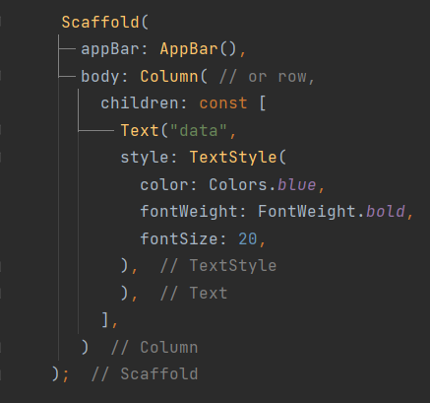
Text
It’s a widget in Flutter that allows us to display a string of text in our application.
You can also change it’s style like color, weight, size and more using TextStyle.
Notes:
First talk about YAML parts of pubspec.yaml YAML (data serialization format)
- It is not a programming language like C++.
- It is not Markup language like HTML.
- YAML is designed to be easily readable and writable by humans.
- It's used for representing configuration settings.
Unlike programming languages such as C++ or Python, YAML doesn't contain functions, conditionals, or loops.

Slide 20
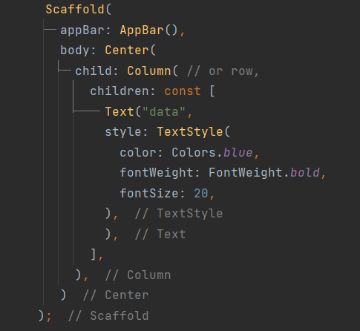
Center
It’s a widget in Flutter that allows us to align the child widget in the center of the screen.
Notes:
First talk about YAML parts of pubspec.yaml YAML (data serialization format)
- It is not a programming language like C++.
- It is not Markup language like HTML.
- YAML is designed to be easily readable and writable by humans.
- It's used for representing configuration settings.
Unlike programming languages such as C++ or Python, YAML doesn't contain functions, conditionals, or loops.

Slide 21
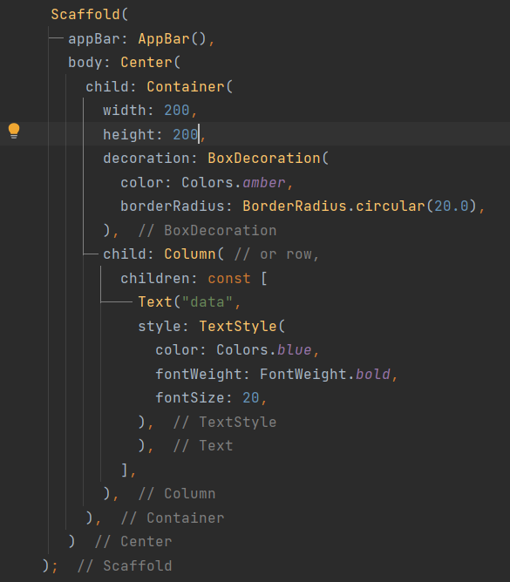
Container
A convenience widget that combines common painting, positioning, and sizing widgets.
Notes:
First talk about YAML parts of pubspec.yaml YAML (data serialization format)
- It is not a programming language like C++.
- It is not Markup language like HTML.
- YAML is designed to be easily readable and writable by humans.
- It's used for representing configuration settings.
Unlike programming languages such as C++ or Python, YAML doesn't contain functions, conditionals, or loops.

Slide 22
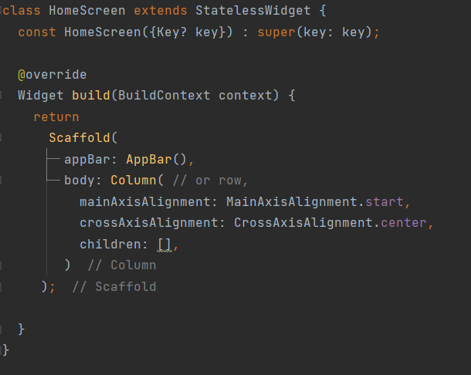
column & Row
the two most important and powerful widgets in Flutter. These widgets let you align children horizontally and vertically as per the requirement.
Notes:
First talk about YAML parts of pubspec.yaml YAML (data serialization format)
- It is not a programming language like C++.
- It is not Markup language like HTML.
- YAML is designed to be easily readable and writable by humans.
- It's used for representing configuration settings.
Unlike programming languages such as C++ or Python, YAML doesn't contain functions, conditionals, or loops.

Slide 23
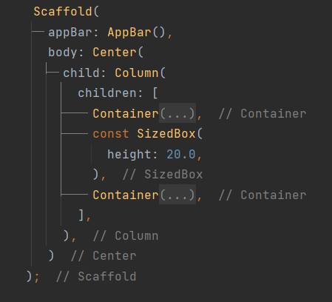
SizedBox
It is somewhat similar to a Container widget with fewer properties. It is a simple box with a specified size. put an empty SizedBox between the two widgets to get some space in between.
Notes:
First talk about YAML parts of pubspec.yaml YAML (data serialization format)
- It is not a programming language like C++.
- It is not Markup language like HTML.
- YAML is designed to be easily readable and writable by humans.
- It's used for representing configuration settings.
Unlike programming languages such as C++ or Python, YAML doesn't contain functions, conditionals, or loops.

Slide 24
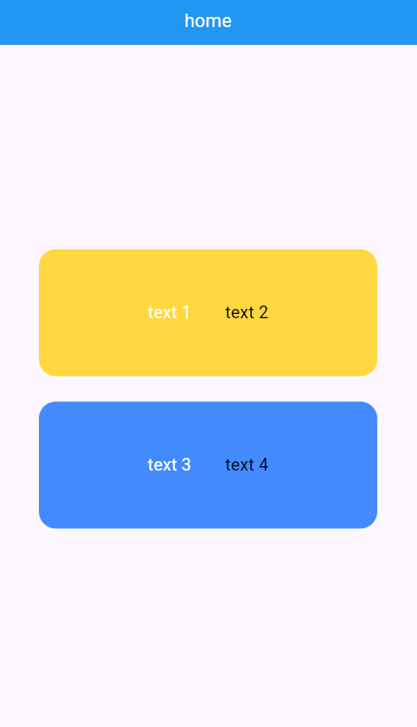
Task
Notes:
First talk about YAML parts of pubspec.yaml YAML (data serialization format)
- It is not a programming language like C++.
- It is not Markup language like HTML.
- YAML is designed to be easily readable and writable by humans.
- It's used for representing configuration settings.
Unlike programming languages such as C++ or Python, YAML doesn't contain functions, conditionals, or loops.

Slide 25
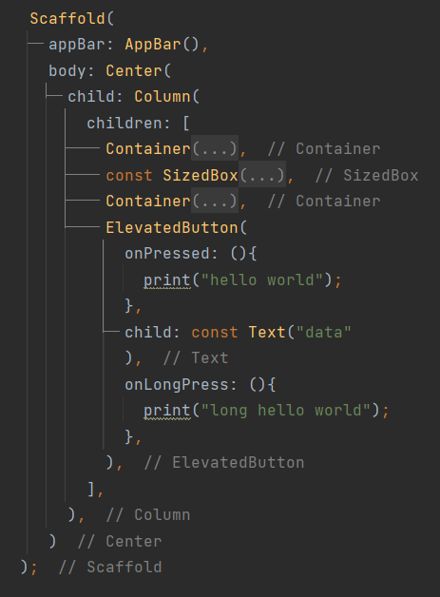
Elevated Button
One of the buttons widgets in flutter. The main characteristic these buttons hold is the slight elevation in their surface towards the screen on getting tapped by the user.
Notes:
First talk about YAML parts of pubspec.yaml YAML (data serialization format)
- It is not a programming language like C++.
- It is not Markup language like HTML.
- YAML is designed to be easily readable and writable by humans.
- It's used for representing configuration settings.
Unlike programming languages such as C++ or Python, YAML doesn't contain functions, conditionals, or loops.

Slide 26
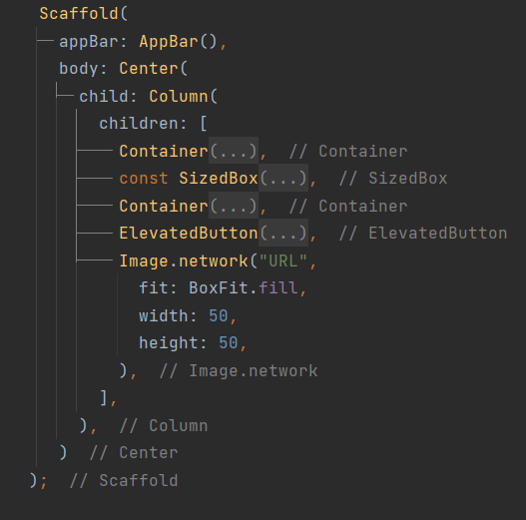
Image.network
Creates a widget that displays an ImageStream obtained from the network.
Notes:
First talk about YAML parts of pubspec.yaml YAML (data serialization format)
- It is not a programming language like C++.
- It is not Markup language like HTML.
- YAML is designed to be easily readable and writable by humans.
- It's used for representing configuration settings.
Unlike programming languages such as C++ or Python, YAML doesn't contain functions, conditionals, or loops.

Slide 27
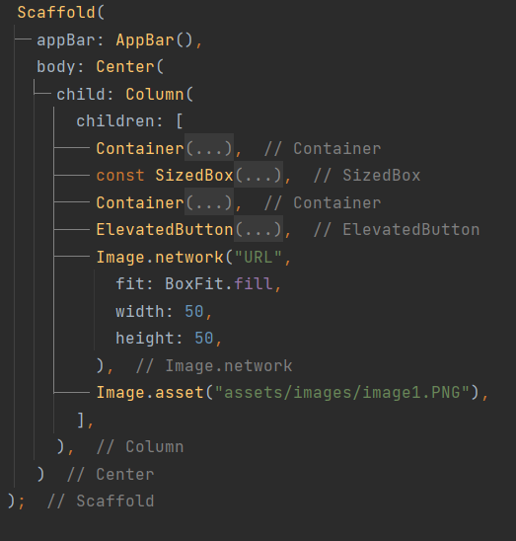
Image.asset
Creates a widget that displays an ImageStream obtained from an asset bundle. The key for the image is given by the name argument.
Notes:
First talk about YAML parts of pubspec.yaml YAML (data serialization format)
- It is not a programming language like C++.
- It is not Markup language like HTML.
- YAML is designed to be easily readable and writable by humans.
- It's used for representing configuration settings.
Unlike programming languages such as C++ or Python, YAML doesn't contain functions, conditionals, or loops.

Slide 28
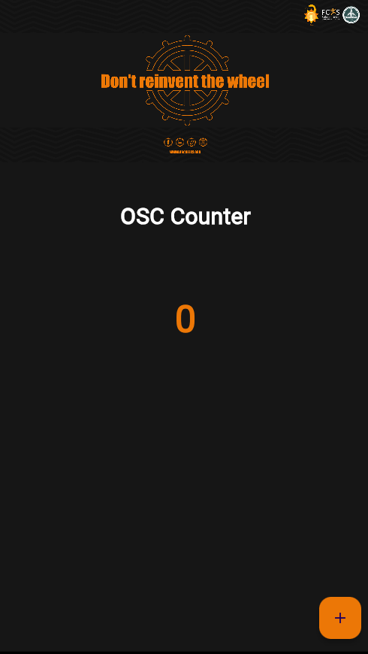
Task
Notes:
First talk about YAML parts of pubspec.yaml YAML (data serialization format)
- It is not a programming language like C++.
- It is not Markup language like HTML.
- YAML is designed to be easily readable and writable by humans.
- It's used for representing configuration settings.
Unlike programming languages such as C++ or Python, YAML doesn't contain functions, conditionals, or loops.

Slide 29


